Slide 1


Pricing Optimality
An Airbnb Case Study
STAT 471 Final Project
Grant Cho | Zhangyi Fan | Margaret Zheng

Slide 2

The
Opportunity
Why should I Value my House?

Slide 3
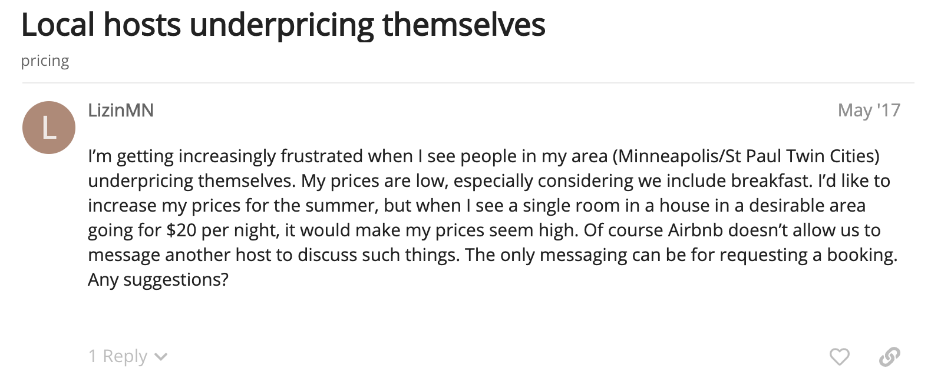

Homeowners aren’t able to price their houses at a satisfactory level
Housing market is extremely saturated
Adverse selection and asymmetric information results in homeowners constantly dropping their prices
Easy to miss out on profit margins
Inexperienced entrants will lose out to veterans
Homeowners will feel less inclined to lease out their homes if the costs begin to outweigh the benefits and if they don’t know the worth of their own properties
60% of potential housing income: property, location, and amenities
40% of housing income: implementing an effective Airbnb pricing strategy
Opportunity
Features
Exploration
Model
Conclusion
Notes:
https://time.com/2345/harvard-study-suggests-racial-bias-among-some-airbnb-renters/
https://www.rentometer.com/articles/my-property-is-not-renting-what-am-i-doing-wrong

Slide 4
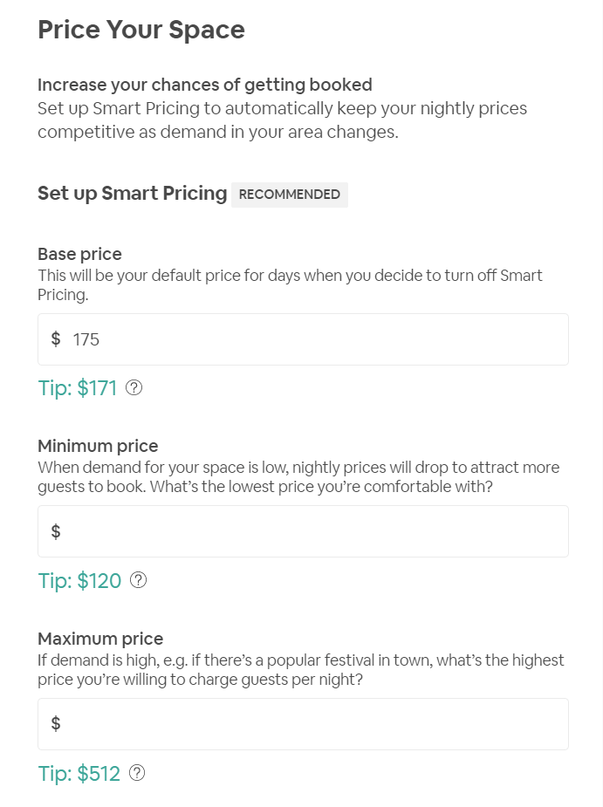
Objective 1: Better Approximate Airbnb Prices
Offerings
Issues
Exhibits
Smart Pricing
Less Ownership Over the Pricing Point
Market-based → No Competitive Edge
Manual Pricing
Suggested price range is usually extremely wide and imprecise - bringing huge fluctuations to the property value
According to Guesty, there is an expectation for the host to stay relevant and competitive by comparing similar Airbnb listing in their area- However the definition of similarities may be ambiguous as there are multiple facets to be considered by a customer
The Challenge
Can we do better than the offerings Airbnb give right now - can we provide homeowners with a greater opportunity to best the market?
Opportunity
Features
Exploration
Model
Conclusion

Slide 5




Objective 2: Examine Effect of User-defined Features
Competitive Prices
Aside from the pricing point, we are also interested in finding out if there are factors unrelated to the house that can boost your property value.
Challenge: Can we tweak some of these variables to bring up the competitive pricing of your house?
Property Description
Microfees
Host Identity
Response Time
Description may affect a customer’s valuation of a property
Smaller fees add up to
A verified homeowner’s identity results in greater build-up of trust
The speed of the response could affect an opportunities worth
Opportunity
Features
Exploration
Model
Conclusion
Notes:
Note that we don’t include location here because that’s not an adjustable variable meaningful to people who have already purchased their homes

Slide 6

Objective 3: Understand Macro Market Trends
Customers have started developing a perception that “house prices never fall”
Housing prices have risen at the third-fastest rate in history over the past several years
Mortgage rates are increasing
Majority of home buyers are millennials
Opportunity
Features
Exploration
Model
Conclusion
Notes:
We can honestly take this slide out
https://think.ing.com/articles/housing-from-consumer-behaviour-to-economy-wide-effects/
https://www.daveramsey.com/blog/real-estate-trends

Slide 7
The
Features
What do people see in my house?

Slide 8
Data Overview and Basic Features
Why Airbnb
Highly Competitive Market with likely correctly priced market value after iterations of testing
Data Source:
Dimensions: 74111 properties and 29 columns | spans across 9 years from 2008 to 2017 in 6 major US cities.
Description
Rental Information
Host information
Location Information
This includes the property type and number of bedrooms
For example: is the rent on a per room basis and/or does it have a cancellation policy?
This includes whether the host is verified or not
Located by city or GPS
Preliminary Feature Engineering
Description, title length and sentiment (using syuzhet package)
Title capitalization
Extracted frequently used words via Text Mining
Opportunity
Features
Exploration
Model
Conclusion

Slide 9
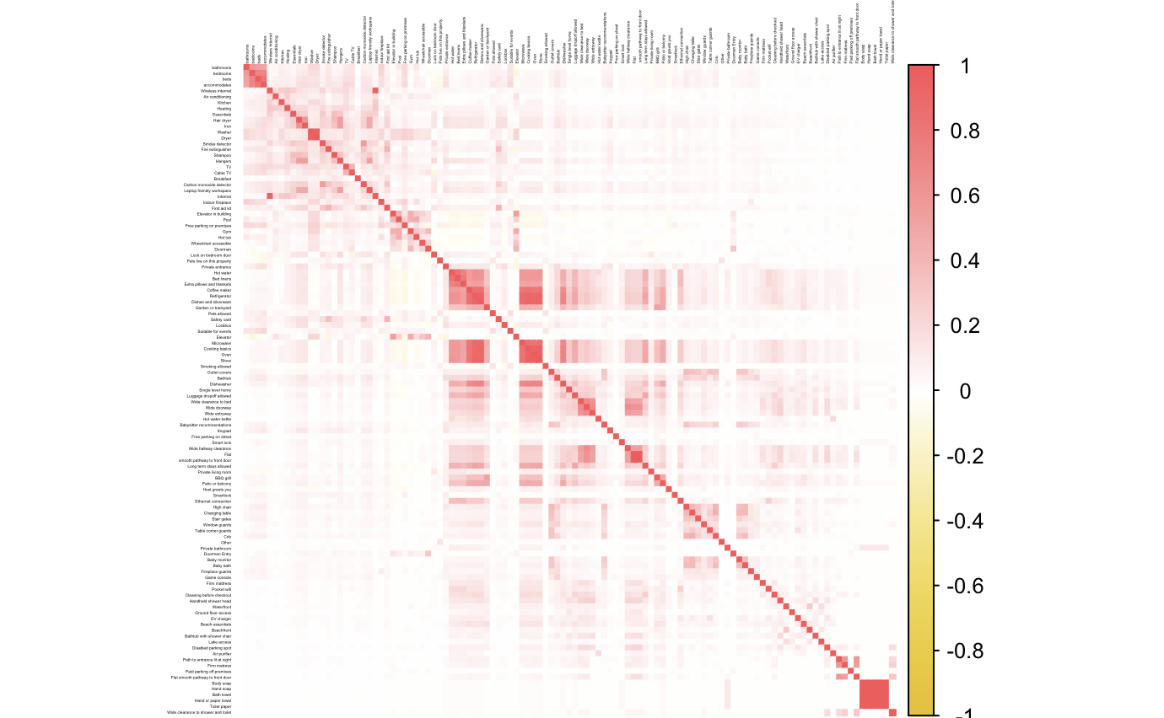

Dimensionality Reduction: PCA
Exploding Dimension
The previous iteration of data preparation left us with 1046 variables
To achieve a more effective EDA process with fewer variables modeled, we also performed dimension reduction for 3 main facets of our variables, leaving us with 29 final features
Physical Information (200 + features)
Description Words (100 + relevant words)
Neighborhood (600+ neighborhoods)
Extracted the top 6 interpretable components (25% of the variations) from Physical features of the house (e.g. # of beds). PCs labeled based on the variables with high loading score
Extracted top 2 interpretable components which accounted for 15% of the variations from words within the property description.
Tabulated the # of descriptive words.
Transformed the neighborhood variable into two numerical value from one-hot encoding:
# of prior listings posted in this area
Distance of the property to the city center
Labeled Components
Cooking
Size_and_basics
Comfort_and_space
Ease_of_access"
Bath_and_Toiletries
Privacy
Labeled Components
Room Based Description (words include: beds, rooms and etc)
Location Based Description (streets, apart, parks)
Descriptive Words
City Based Coordinates
DC 38.8977° N, 77.0365° W (WHITE HOUSE)
NYC 40.7527° N, 73.9772° W (GRAND CENTRAL)
SF 37.7946° N, 122.3999° W (FINANCIAL DISTRICT)
BOS 42.3557° N, 71.0572° W (DOWNTOWN)
LA 34.0687° N, 118.3228° W (CENTRAL LA)
Chicago 41.8786° N, 87.6251° W (THE LOOP)
Opportunity
Features
Exploration
Model
Conclusion

Slide 10
Final Data Summary
Final Filtering
Note: From here onwards, we filtered out houses with fewer than 3 reviews and placed them into a holdout set. We did this since we don’t have any guarantee that these houses are priced at market condition since they are not frequently transacted
Final Data
Location Information
2 dimension reduced variables and 5 dummy variable for the housing city
Physical Information
6 dimension reduced variables
User Based Information
22 variables including amenable information about the house (including sentiment and words in the title & description, fees, host identity and response time)
Next Steps
Final Data Dimension: 46435 x 29
EDA
Modelling
Output interpretation
Opportunity
Features
Exploration
Model
Conclusion

Slide 11
The
Exploration
What relationship do we hypothesize?

Slide 12
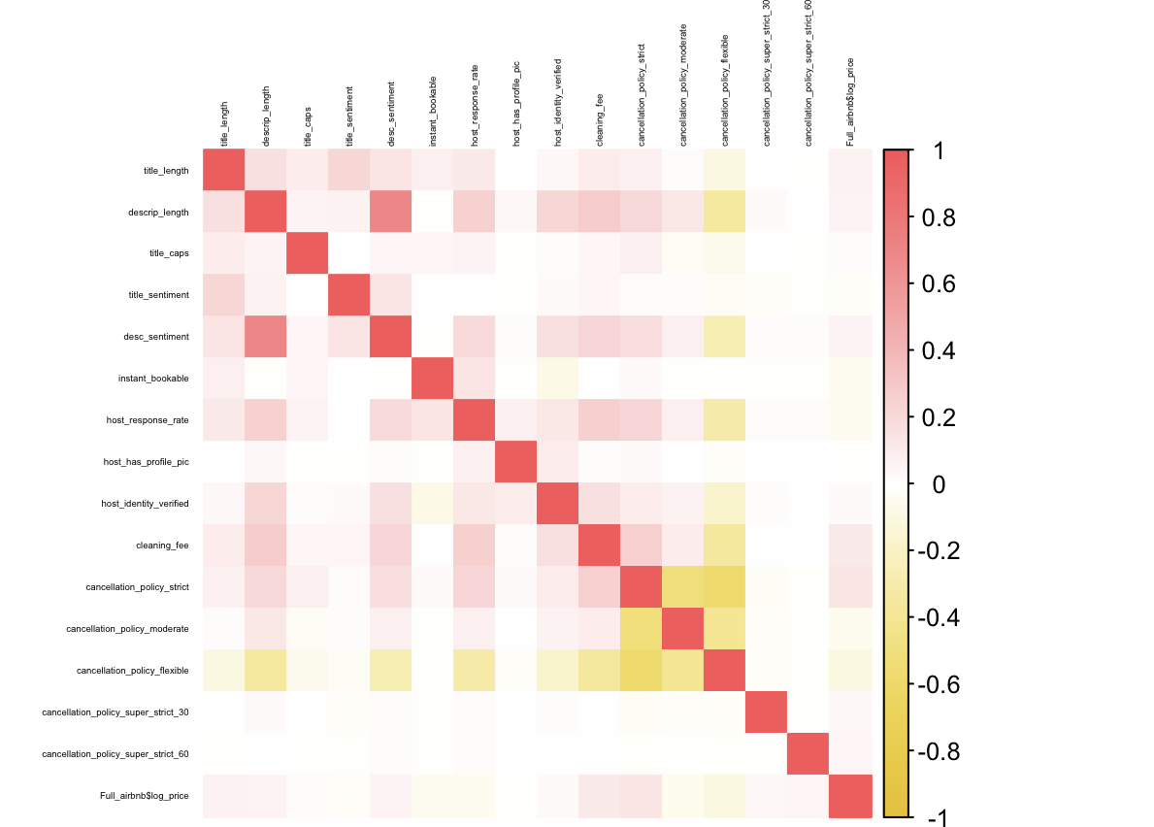
Correlation Matrix: User-based Features
General Association Trends
Cancellation Policies are mutually negative
Description Length is strongly Linked with sentiments (likely due to repeated use of positive words)
Cleaning fee, description length and host response rate are closely associated (the degree of host attention and engagement)
Observation 1
Interestingly, having high cleaning fee and a strict cancellation policy seems to positively related to price, while having a flexible policy actually negatively correlates with the price
Hypothesis 1
There might be some external factors carried over in those factors that serves as a proxy for the “class” of the house. We hypothesize this trend to diminish as we control for factors like amenities
Opportunity
Features
Exploration
Model
Conclusion
Notes:
Observation 1 might be because the more in demand places = pricier can get away with things like that

Slide 13
Correlation Matrix: User-based Features
General Association Trends
Cancellation Policies are mutually negative
Description Length is strongly Linked with sentiments (likely due to repeated use of positive words)
Cleaning fee, description length and host response rate are closely associated (the degree of host attention and engagement)
Observation 2
Title length, description length and description sentiment all have rather positive relation with the housing price as well
Hypothesis 2
We believe that this signals that the wording attached with the house MAY affect housing prices - we hypothesize that the effect will be positive due to the power of marketing and glamorization.
Opportunity
Features
Exploration
Model
Conclusion

Slide 14
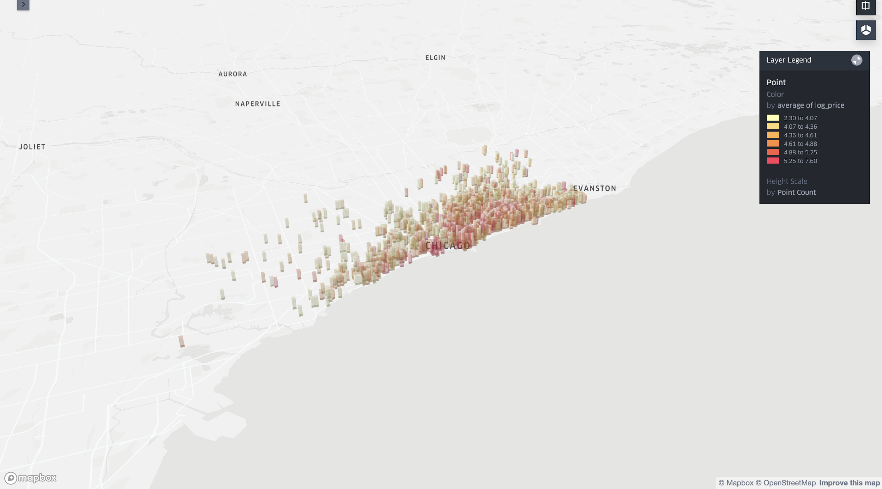
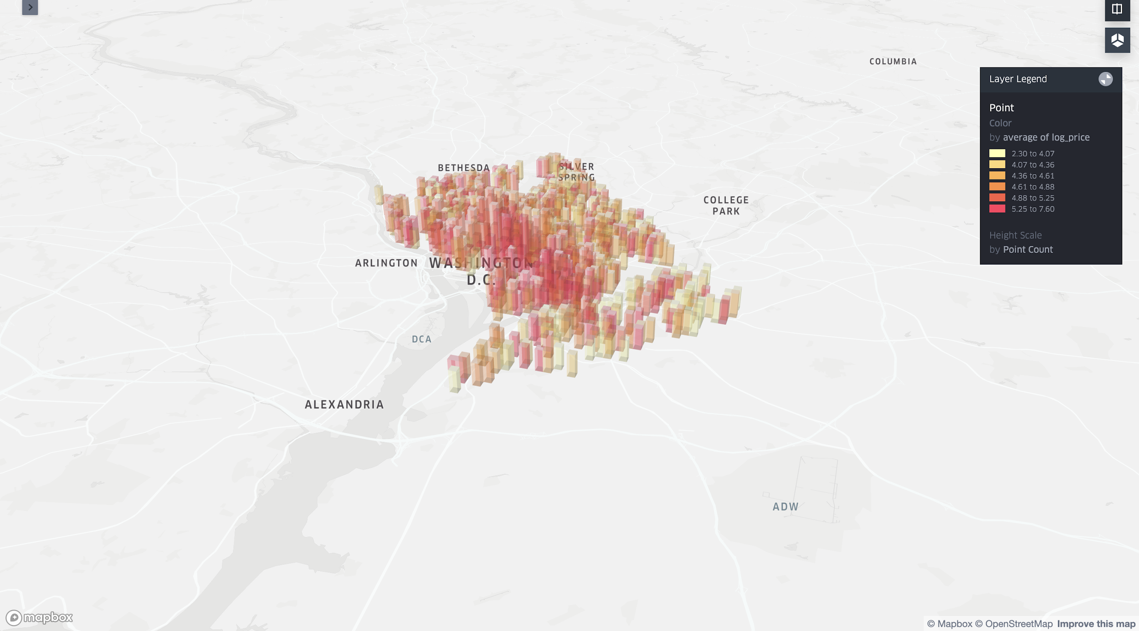
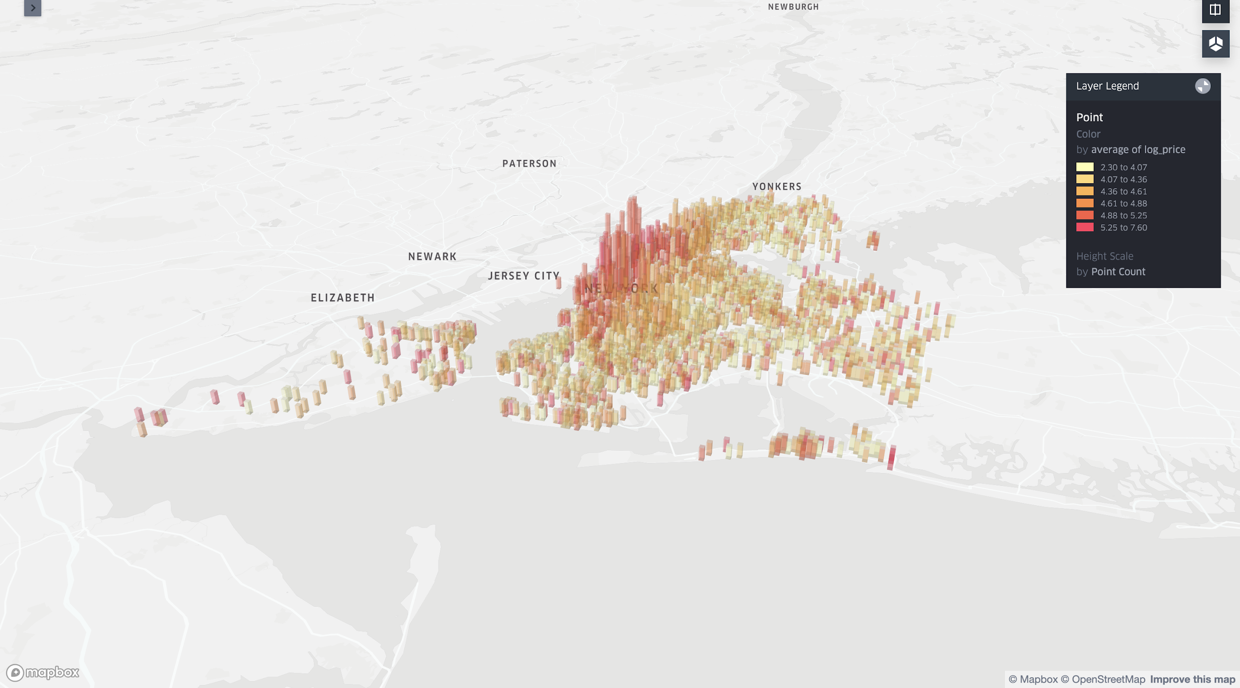
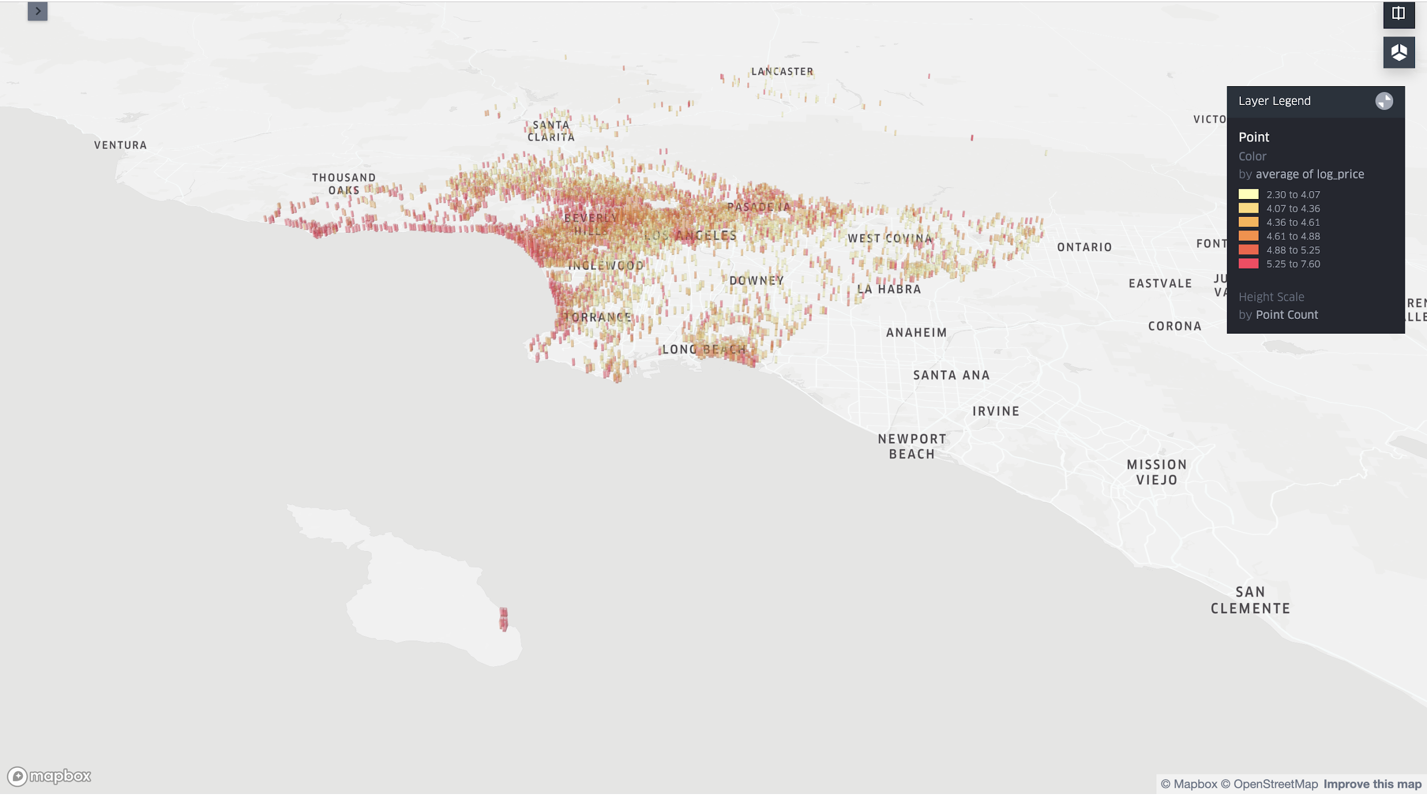
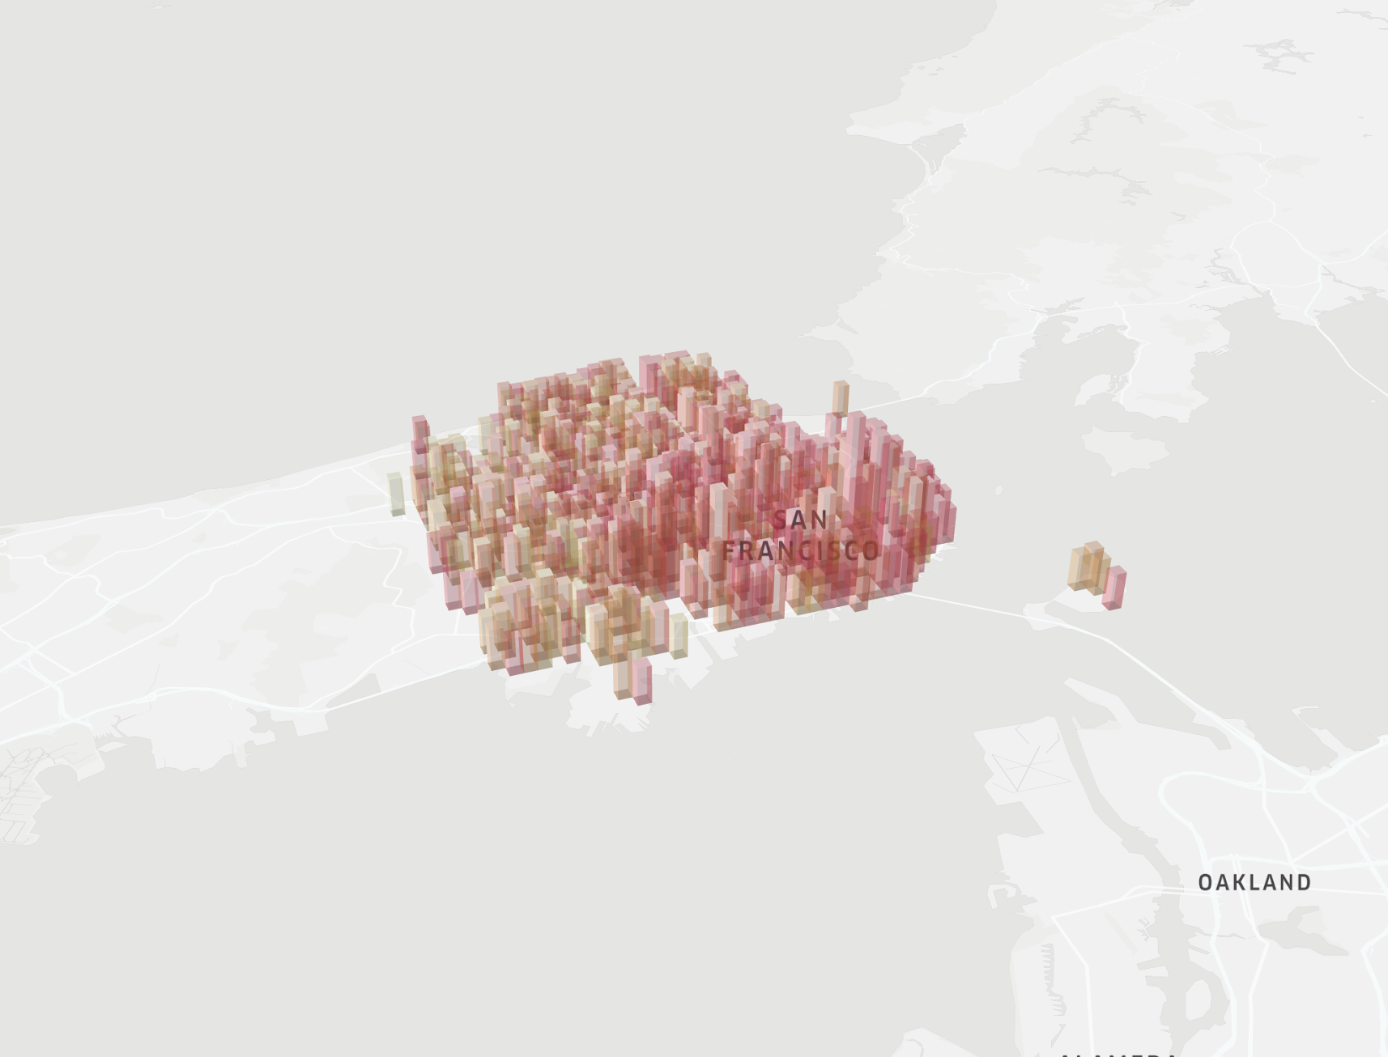
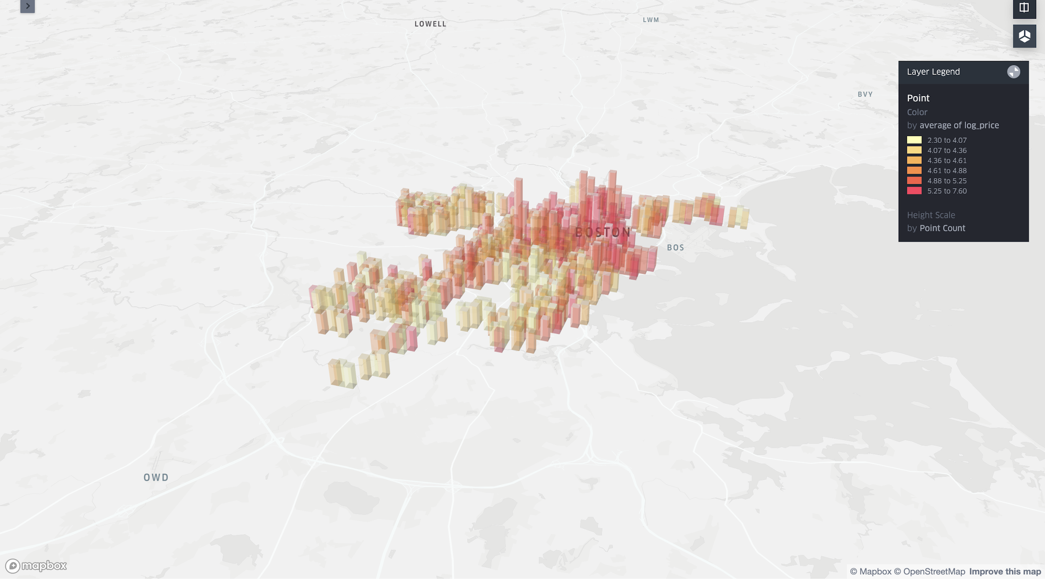
Usage and Pricing of Airbnbs in Different Cities
Chicago & LA: Coastal Surge
Opportunity
Features
Exploration
Model
Conclusion

Slide 15
Usage and Pricing of Airbnbs in Different Cities
SF & DC: Even Spread and Price
Opportunity
Features
Exploration
Model
Conclusion

Slide 16
Usage and Pricing of Airbnbs in Different Cities
NY & Boston: Dense Central Areas
Opportunity
Features
Exploration
Model
Conclusion

Slide 17
Usage and Pricing of Airbnbs in Different Cities
We hypothesize that there exist city wide differences that needs to be mapped out into the model
Opportunity
Features
Exploration
Model
Conclusion

Slide 18
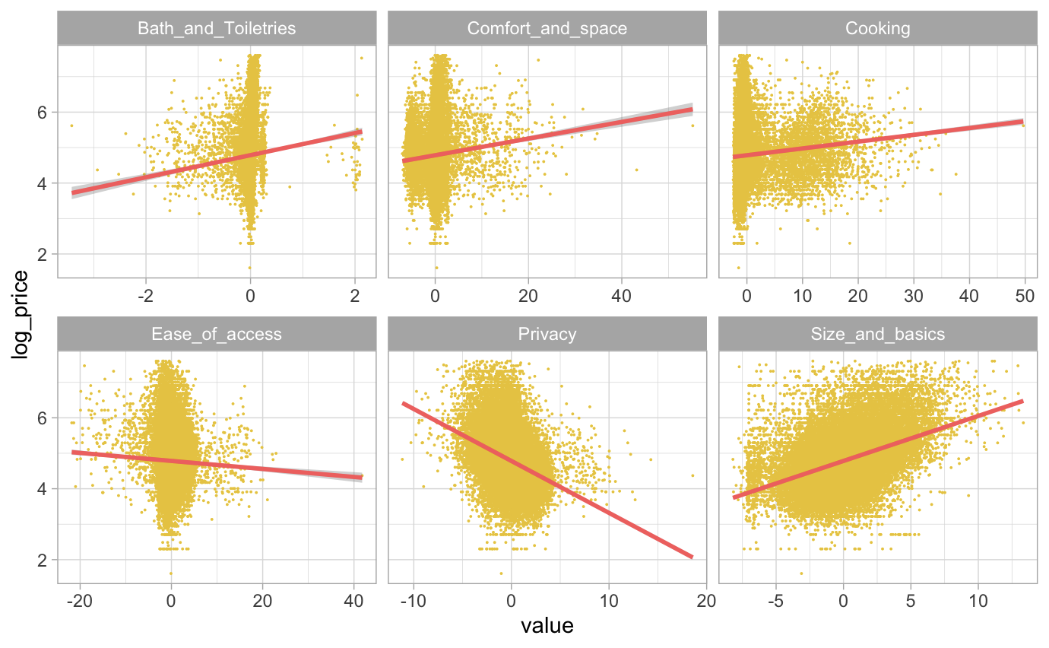
Housing Prices across Physical Principal Components
Housing Price (Logged) Across Physical PC Index
Opportunity
Features
Exploration
Model
Conclusion

Slide 19
Housing Prices across Physical Principal Components
Housing Price (Logged) Across Physical PC Index
Observations
Bath room, space, cooking and size related physical features appeared rather strongly & positively correlated with housing price
Hypothesis
This seems rather likely, given that all those features seems like rather crucial for any renter We hypothesize that they will continually be positive in later analysis
Opportunity
Features
Exploration
Model
Conclusion

Slide 20
Housing Prices across Physical Principal Components
Housing Price (Logged) Across Physical PC Index
Observations
Observations
Surprisingly, privacy and the ease of access related features seems to be negatively related to the price of interest (Privacy, in particular)
Hypothesis
Hypothesis
We hypothesize that this may be due to the trade off attached with these choices. (Higher privacy may indicate that this is a shared room or a smaller compartment) causing this trend to be negative. We hypothesize that this may be different post controlling other variable.
Opportunity
Features
Exploration
Model
Conclusion

Slide 21
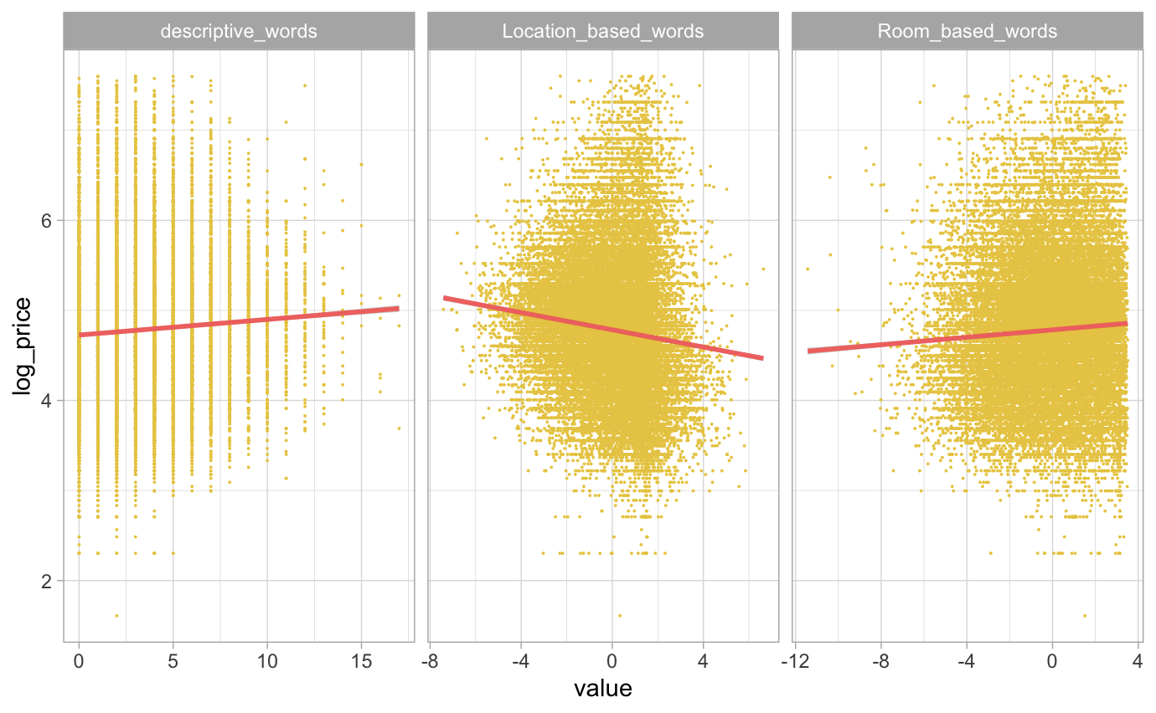
Housing Prices across Word Based Index
Housing Price (Logged) Across Word Based Index
Observations
Observations
Descriptive Words and Room Based Words both seems to have a positive relationship with the housing price, while location based words seems to have a negative relationship
Hypothesis
Hypothesis
We hypothesize that this trend will persist - our rationale is that descriptive words and room based words are more appealing to the intrinsic needs and wants of the customers, while location based words does not add additional value, but may instead decrease value if the location appear suboptimal
Opportunity
Features
Exploration
Model
Conclusion

Slide 22
The
Model
How much?
Notes:
Using engineered features + dimensionality reduced data
Predict optimal price point for each listing

Slide 23
Model Results & Selection
Models
Cross Validation
Test Results
Relaxed LASSO: adding bias by penalizing coefficients to create a sparser model to better estimate testing errors
Random Forest: generating many uncorrelated decision trees to improve prediction accuracy
Neural Network: algorithms designed to recognize patterns, interpreting sensory data by labeling or clustering raw inputs
XGBoost: implementation of gradient boosting for decision trees algorithm, optimized for speed and performance. A gradual, additive model is generated, with decision trees added to minimize the loss function.
Used 10 fold Cross Validation to tune the the hyperparameter and loss function:
Relaxed Lasso: Tuned Lambda to perform feature selection
Random Forest: Tuned mtry (14) and number of trees (elbowed at 450) | OOB Prediction Error: 0.483 on Logged Price
Neural Network: Validation set used to evaluate trained model | CV Mean Absolute Error: 104 on Actual Price
XGBoost: Tuned eta (learning rate) and nrounds (number of training iterations) | CV Error: 0.486 on Logged Price
The final Evaluation results on the test data are as follows (Evaluated on the mean squared error & the mean absolute error of the actual housing price):
Relaxed Lasso MSE: $188
Relaxed Lasso MAE: $75
Random Forest MSE: $136
Random Forest MAE: $62
Neural Network MSE: $187
Neural Network MAE: $102
XGBoost MSE: $138
XGBoost MAE: $63
RF >= XGBoost > Relaxed Lasso >= Neural Network
Opportunity
Features
Exploration
Model
Conclusion
Notes:
Using all the features, we test 4 main models.
What is XGBoost
Gradient Boosting optimizes for loss at every iteration of training
10 fold CV to tune hyperparameter & loss function
For our final results- evaluated on MAE and MSE
our best model is the Random Forest (results). This is a results, improvement from range of $400 in the first slide (manual pricing range)- to $62-136; XGBoost performed similarly, while neural net and lasso were least successful.

Slide 24






Feature Interpretation
Important Variables
Specific Feature Findings
The Physical components are most significant (Both Random Forest and XgBoost placed the physical component of the Top 7 in information gain).
Location variable were significant by the selection of Lasso and the information gain criteria of Random Forest , but not in the boosting tree.
Select user based features did appear significant in lasso selection and the ensemble models (sentiments and identities). Furthermore we tested the F-statistics for the model with and without user based feature and obtained an F Score of 84, and a p-value of <0.001 - leading us to the conclusion that user based feature does matter
Houses with more amenities and perks are pricier to rent
It’s like comparing furnished with unfurnished apartments: the more completed the house, the more valuable homeowners believe their property is
People prefer long title and high description sentiments
These in general appeals more to public’s mindset when making a purchase
3 Most Important Variables: Size and basics, privacy, and bath and toiletries
Customers prioritize openness and completion of houses so they don’t get bored or have to shop
Opportunity
Features
Exploration
Model
Conclusion
Focus on user decided features: anything not 6 physical PC related. Talk about which variables significant.
Notes:
Summary of the coefficient results
Read the first two
Selected user based features
F test → user based features do matter
Echos our hypothesis earlier

Slide 25
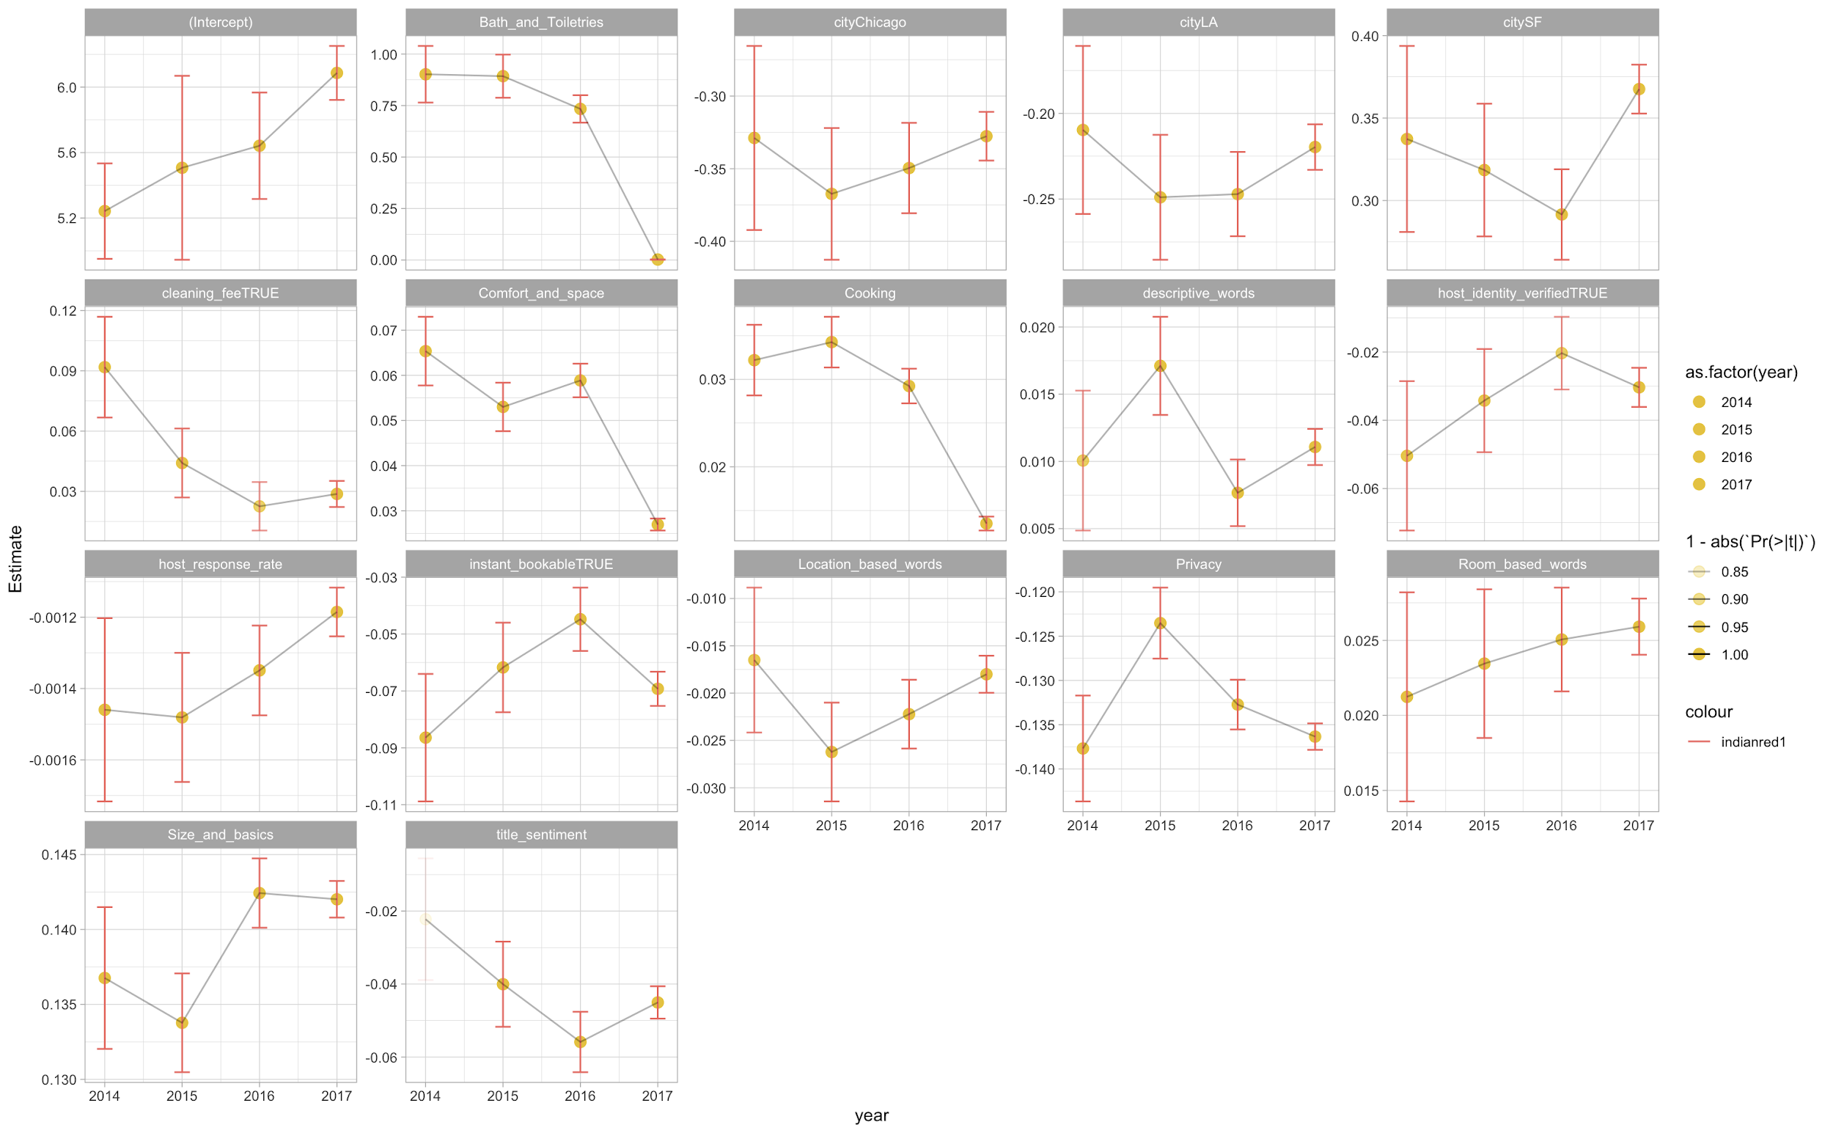
Analyzing Consumer Preferences: 2014-2017
Rationale
To answer our third objective, of macro trends we performed a regular regression on the data partitioned by the year when the house is last reviewed.
We are specifically interested to see whether or not consumer preference has changed with regards to particular domains/features of the house
The graphic to the right are the factors that we’ve compiled which showed a significant effect through the four years.
Opportunity
Features
Exploration
Model
Conclusion
Notes:
To address our third objective of understanding the macro market trends

Slide 26
Analyzing Consumer Preferences: 2014-2017
Observation and Interpretation
Amenities such as Bathroom and Toiletries, The Comfort and spaciousness, and Cooking affiliated features have all gone down in effect in the past years (particularly in 2017) have actually decreased in effect over the past 4 years
We believe this may be due to the completeness of these amenities in more and more houses (diminishing its uniqueness in value)
Opportunity
Features
Exploration
Model
Conclusion
Notes:
More normalized, must have
Does not boost value of your house

Slide 27
Analyzing Consumer Preferences: 2014-2017
Observation and Interpretation
Host identity, host response rate have both increase in its effect in the past years, along with the house being instantly bookable
This could be explained by the increasingly valued factor of convenience in the context of electronic services. People want things quick!
Opportunity
Features
Exploration
Model
Conclusion

Slide 28
Analyzing Consumer Preferences: 2014-2017
Observation and Interpretation
Size and basics also increased in its effect, with a big jump from 2015 to 2016; Parallel to what we observe for people less inclined to prefer Private houses
The uses of Airbnb has evidently grown and more frequently used in the different aspects (such as bigger party travels), we believe that contributed strongly to this observe trend of an increasing emphasis in house size
Opportunity
Features
Exploration
Model
Conclusion
Notes:
Inverse trend between size and basics and privacy
More open house rather than privacy

Slide 29
The
Conclusion
What now?

Slide 30
Impact Assessment & Conclusion
We ran our best performing Algorithm (Random Forest) on the Holdout set identified earlier and obtained the results below
Last Note
To end our analysis, we want to offer a couple of advice regarding how to optimize for the value of your house:
Offering basic amenities is a must
Put time into writing a good description
Some keys features (i.e. size and basics) are inflexible and cannot be changed.
Number of Review <dbl> | Predicted Value <dbl> | Actual Value <dbl> | count <int>
0 | 137.4452 | 159.9591 | 15819
1 | 137.5179 | 158.1658 | 7106
2 | 137.9504 | 160.0821 | 4750
key Items | value % of household with said item
bed_type_Real Bed | 97.1%
Internet | 96.6%
Wireless Internet | 96.1%
Some Must Haves
Evidently, for these houses, the actual value all seems to be higher than their predicted value by about $20. We believe this may have strongly contributed to these houses not performing well (being rented or traded) on the market. With this algorithm we believe this situation could be remedied and fixed.
Opportunity
Features
Exploration
Model
Conclusion

Slide 31
Thank
You!
Any Questions?

Slide 32
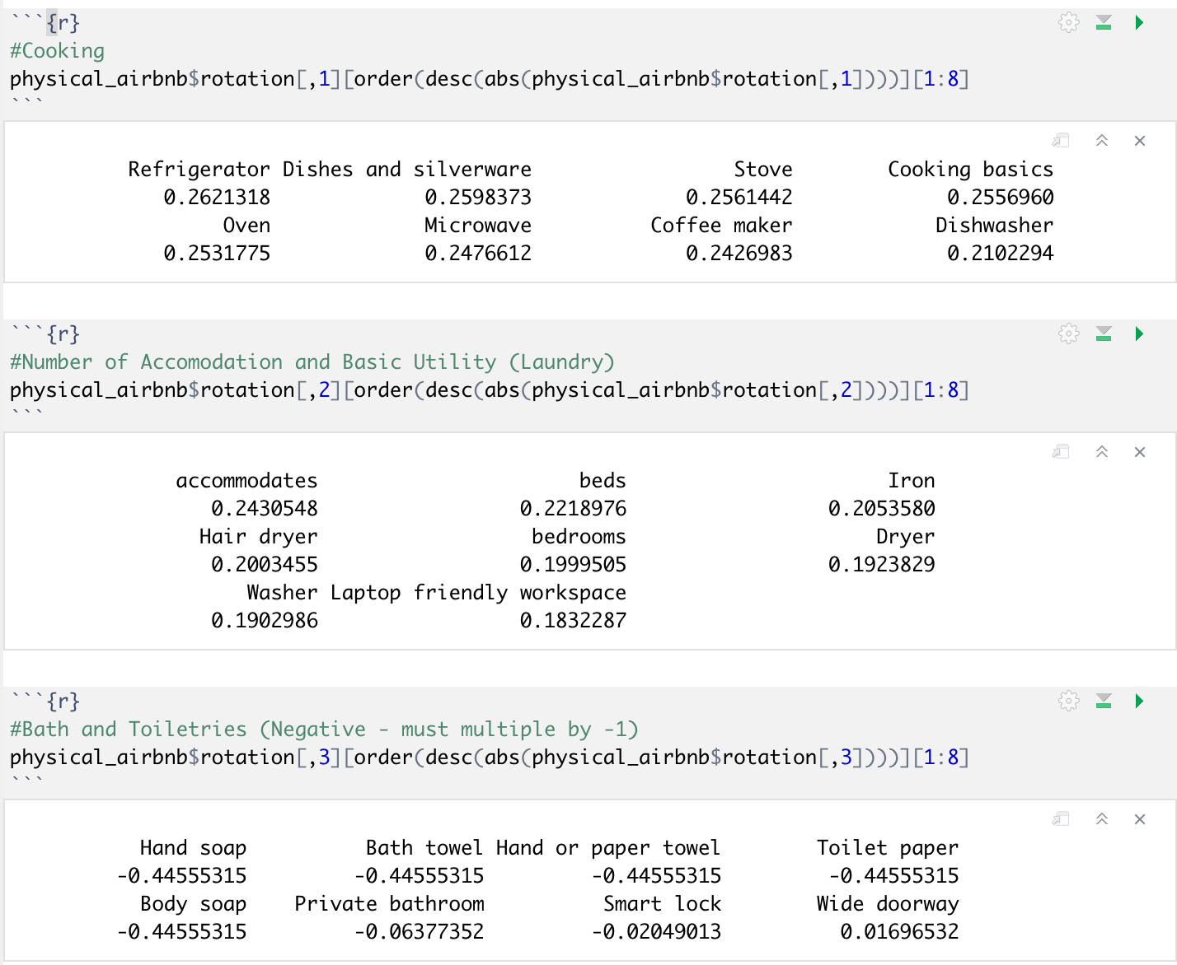
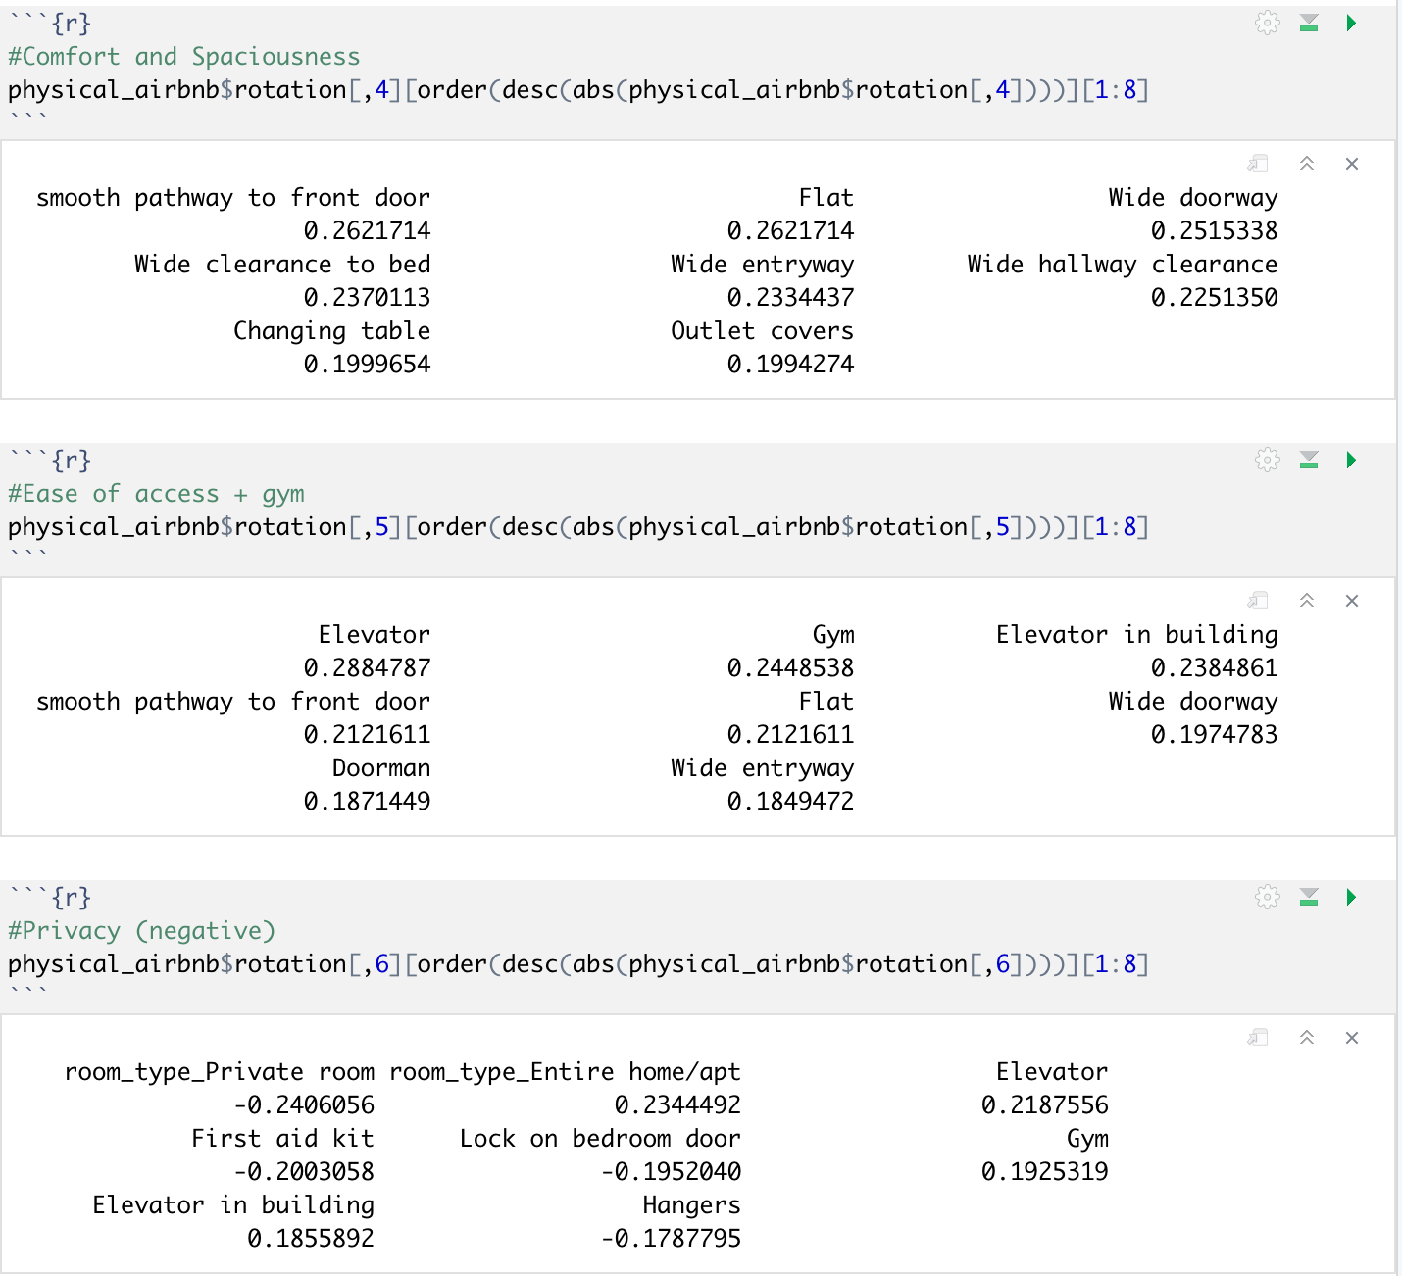
Appendix

Slide 33
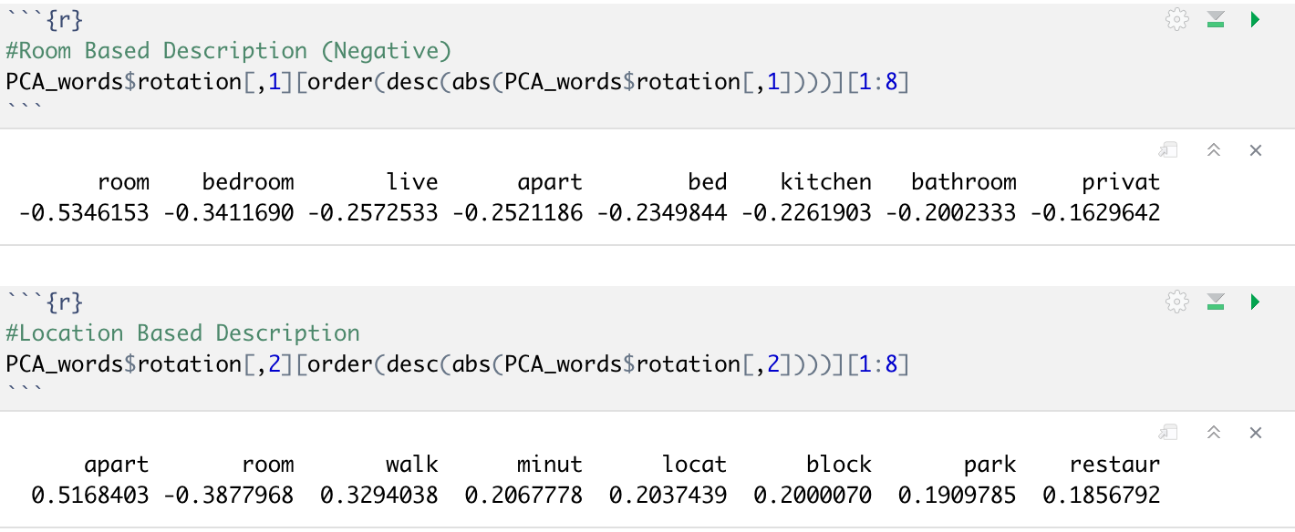
Appendix

Slide 34
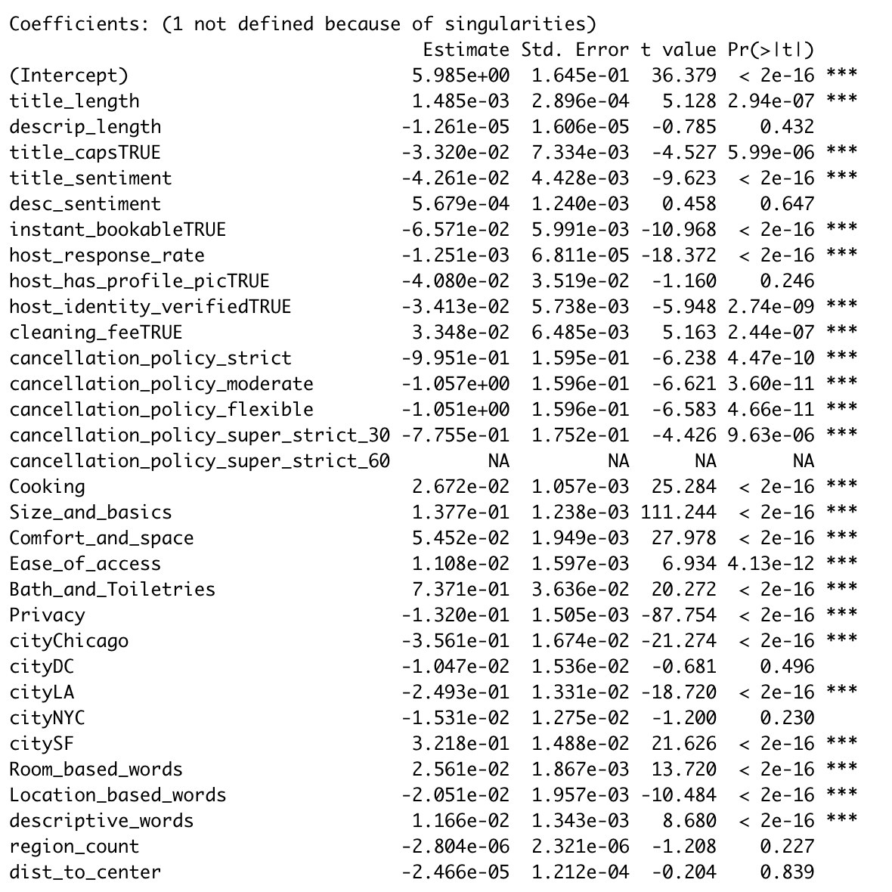
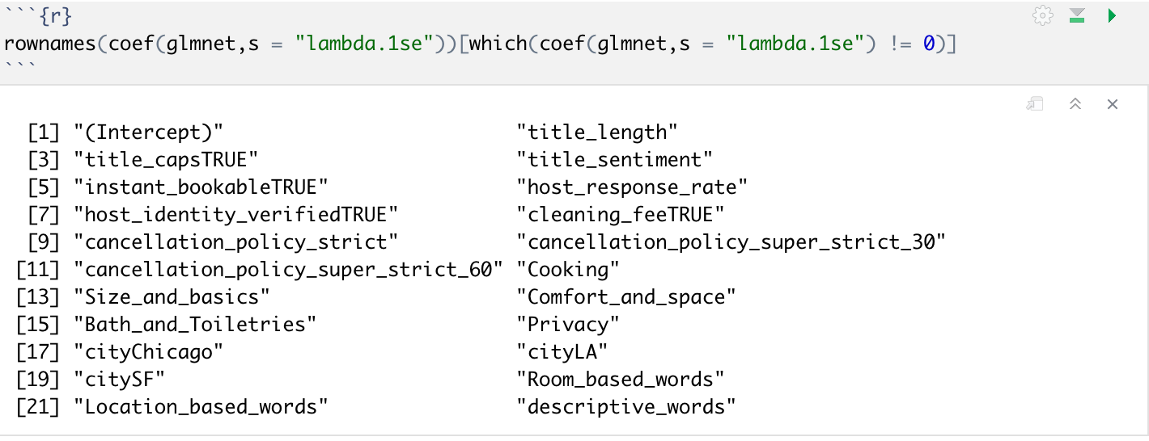
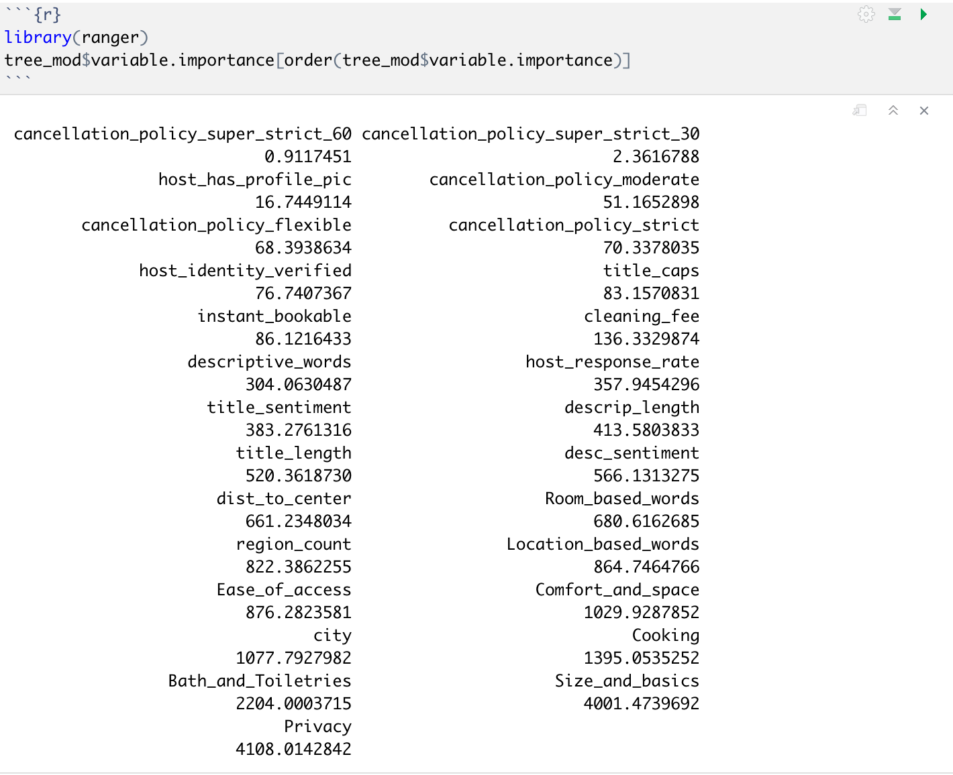
Appendix

Slide 35
Appendix
Feature <chr> | Gain <dbl>
Size_and_basics | 1.841854e-01
Privacy | 1.560231e-01
Bath_and_Toiletries | 8.465730e-02
Cooking | 5.431437e-02
Location_based_words | 5.173452e-02
Comfort_and_space | 5.000975e-02
Ease_of_access | 4.880424e-02
region_count | 4.695374e-02
Room_based_words | 3.190781e-02
title_length | 3.168725e-02
descrip_length | 3.100122e-02
desc_sentiment | 2.850914e-02
dist_to_center | 2.556444e-02
title_sentiment | 2.397669e-02
host_response_rate | 2.178417e-02
cityLA:dist_to_center | 1.844748e-02
cityNYC:dist_to_center | 1.571838e-02
citySF:dist_to_center | 1.527415e-02
descriptive_words | 1.116784e-02
cityDC:dist_to_center | 1.030116e-02
cityChicago:dist_to_center | 6.026075e-03
citySF | 5.942693e-03
cityLA | 5.663061e-03
cityDC | 4.995790e-03
title_capsTRUE | 4.873473e-03
instant_bookableTRUE | 4.732435e-03
host_identity_verifiedTRUE | 4.688795e-03
cleaning_feeTRUE | 4.551411e-03
cancellation_policy_flexible | 4.440060e-03
cancellation_policy_strict | 3.601844e-03
cancellation_policy_moderate | 3.176857e-03
cityNYC | 2.778721e-03
cityChicago | 1.805336e-03
host_has_profile_picTRUE | 6.435642e-04
cancellation_policy_super_strict_30 | 4.292174e-05
cancellation_policy_super_strict_60 | 1.485008e-05

